Slide 1
Cost Minimization with Expansion
By: Noreen Mayat

Slide 2
Task Overview
Goal: How best to minimize costs during warehouse expansion
Current Costs:
Annual Warehouse Spend: $150K
Annual Shipping Costs: cost ($) to ship packages throughout USA
Sales Growth Rate: 15% YoY
Increased Sales → Increased Shipments → Increased Costs
Our strategy for expansion ensures the company will reduce costs while improving existing sales.
Notes:
Our client is a fast-growing company selling widgets across the continental US. Our consulting team believes that as the company expands, they may benefit from moving from a single distribution warehouse (currently located in Syracuse, NY) to multiple distribution points.
Minimizing costs during business expansion is challenging, especially given our existing warehouse maintenance and shipping costs.
But with our rapid growth rate in sales of 15% a year, expansion may be necessary to continue supporting our business.

Slide 3
Current Rates
Distance | Price
< 500 mi | $5.60 / package
< 1250 mi | $8.70 / package
> 1250 mi (continental USA) | $11.90 / package
Air Freight | $18.00 / package
The company pays the following shipping rates:
We can assume all packages have a uniform price.
Shipments have surcharges.

Slide 4
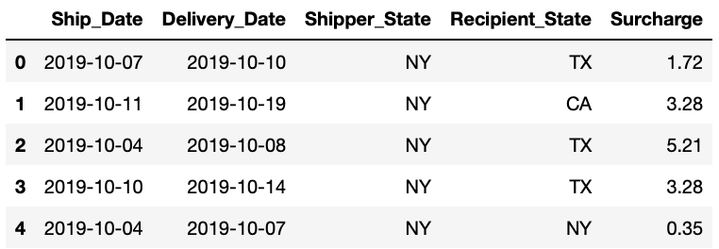
Data Summary
We were given 1 month of data for 8,512 shipments from October 1st, 2019 - November 1st, 2019.
We assume October’s sales represent our monthly costs.

Slide 5
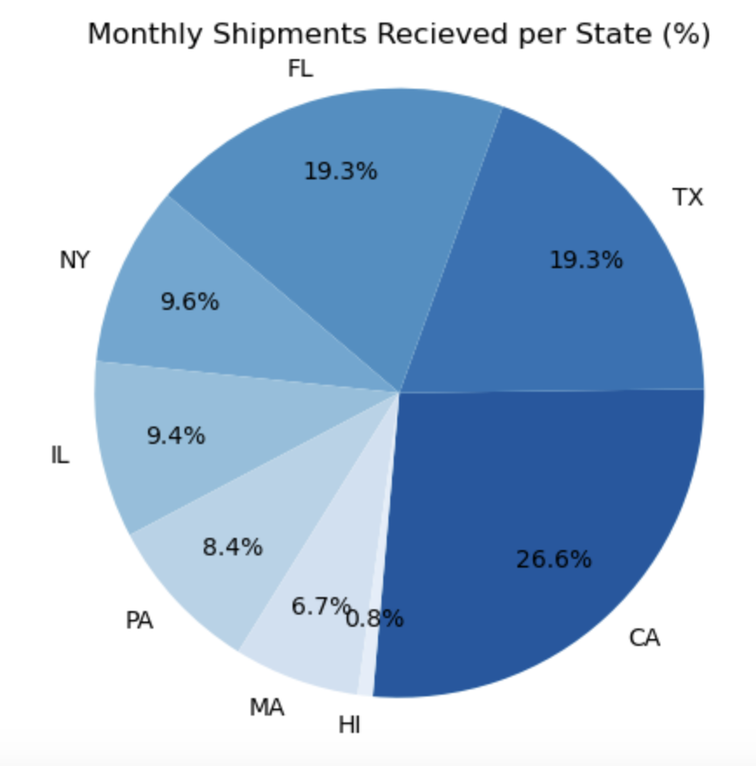
Current Trends
Top 3 Shipment Recipient States: California, Texas, and Florida
CA shipments make up ~27% of our total monthly shipments.
HI shipments make up <1% of our total monthly shipments.
Notes:
We should keep this information in mind as we determine our best savings opportunities; California is also one of the farthest (and thus has the most expensive shipping cost) states from New York within the continental United States.
Although Hawaii is the farthest state from New York, and has the most expensive shipments due to air freight

Slide 6
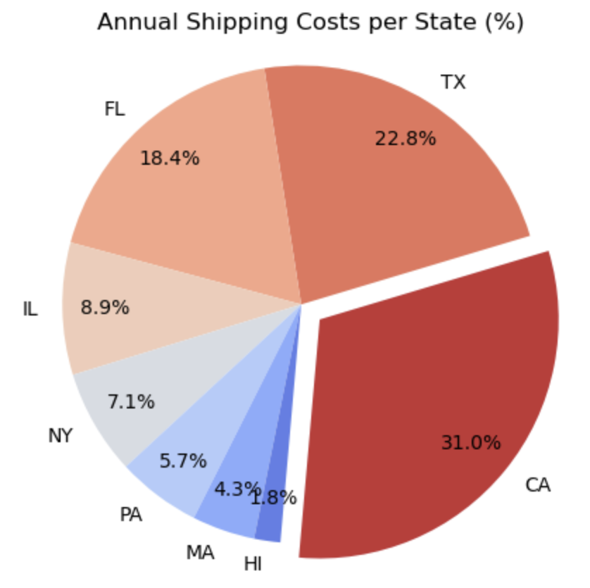
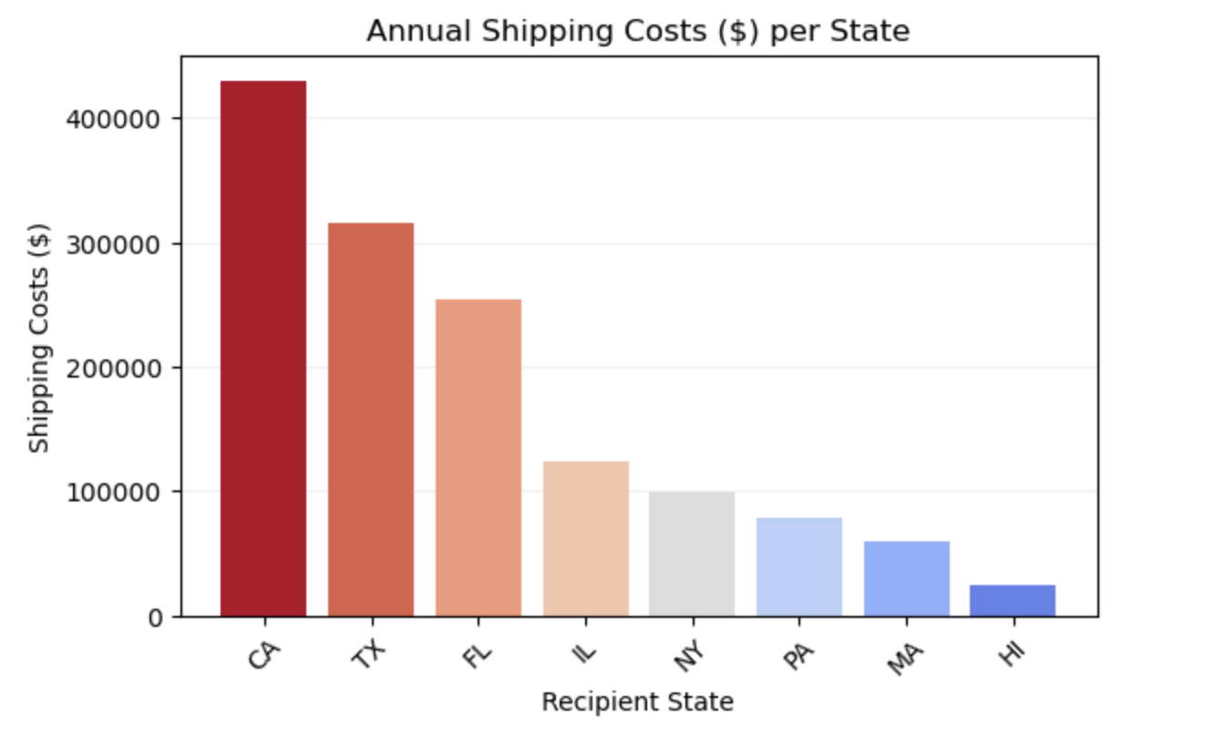
Current Trends
Notes:
The state with the highest shipment costs is CA.

Slide 7
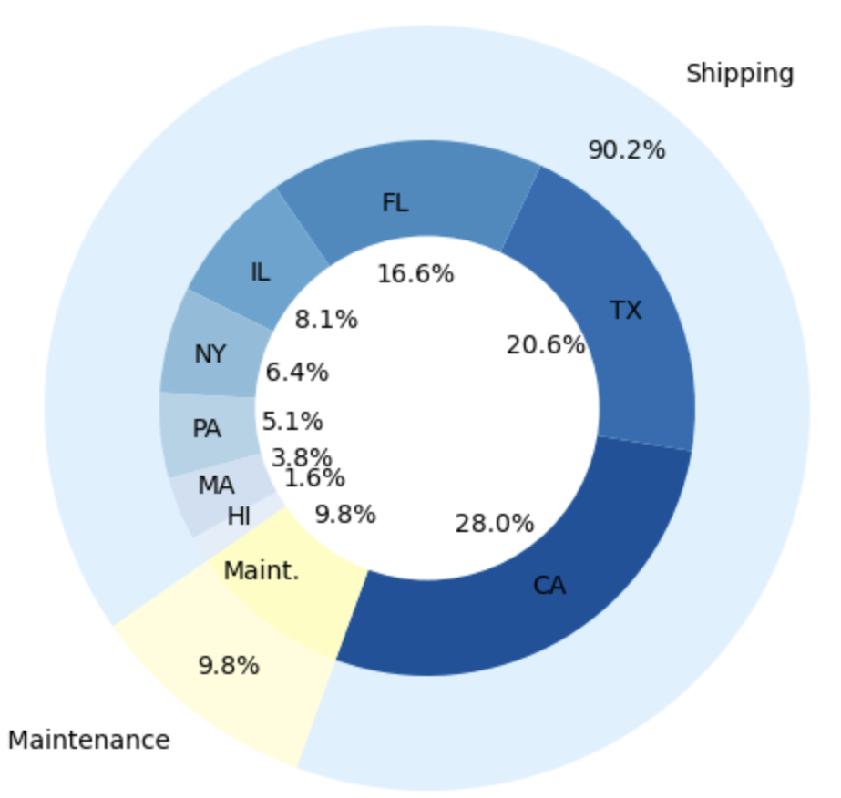
Current Trends
Total Annual Cost Breakdown
Current Total Annual Costs: $1.5M
Shipping Costs: $1.4M
Warehouse Maintenance: $150K
Shipping costs make up ~90% of our total annual warehouse costs.
31% of these shipping costs are just our packages to CA.
We spend $429,255.84 on shipping packages to CA, annually.
This is 28% of our total costs.
Notes:
From the last slide, Shipments to CA from our warehouse location in Syracuse, NY make up approximately 31% of our annual shipping costs, and 28% of our total annual costs.
This is significant, compared to what percent shipments to other states make up of our total shipping costs.
Shipments to Texas, which is the second top shipment recipient state, make up roughly 21% of our total annual costs, and shipments to Hawaii, although most expensive due to the air freight cost, make up less than 2% of our total annual costs.

Slide 8
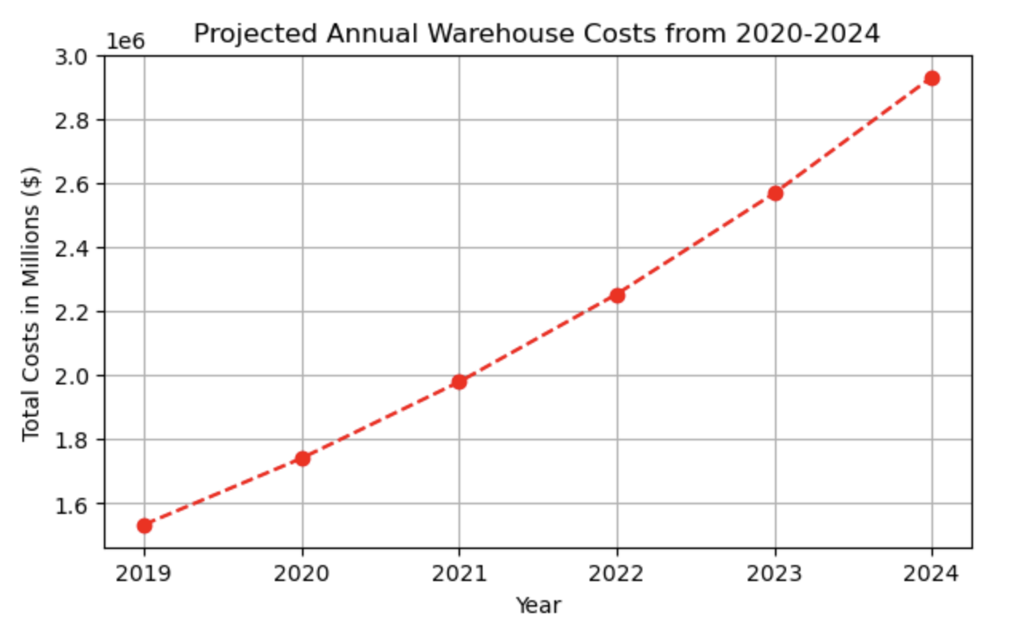
Current Trends
✕ 2
With our 15% YoY growth rate, we can expect our total annual costs to almost double over the next 5 years.

Slide 9
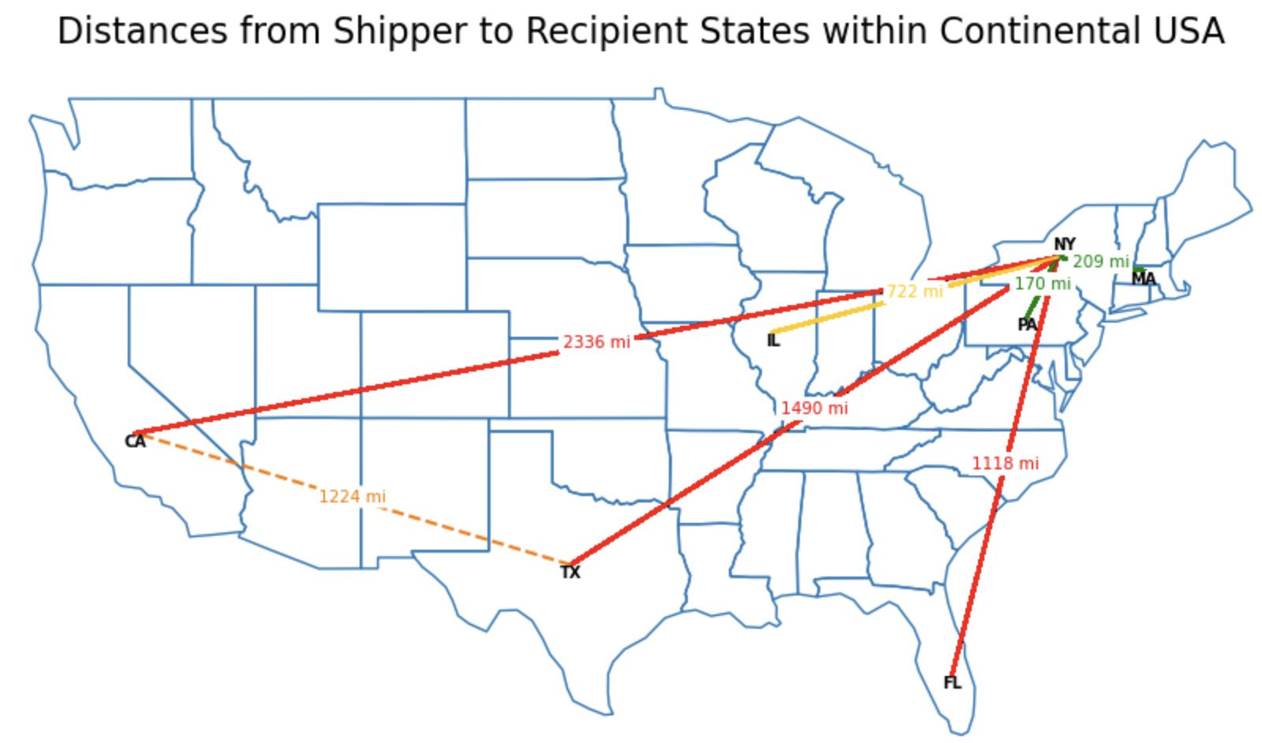
Savings Opportunities
Notes:
We observe our farthest distances for shipments are to California, Texas, and Florida.
We know shipments to California are costing us the most money, as shipment prices are mainly based on distance--so opening up an additional distribution point in CA is most likely a strong savings opportunity for us.
Furthermore--geographically, Texas and California are closer apart than Texas and New York. This difference in distance is prety significant; since the distance between TX and CA is <1250 mi, another warehouse in CA would bring down shipping costs per package from the current rate of $11.90/package when shipping from NY to TX to $8.70/per package when shipping from CA to TX.
Given Texas is our top second shipment location, another warehouse in California would reduce these shipping costs to TX, making a warehouse in CA would be an optimal savings opportunity.

Slide 10
Savings Opportunities
To calculate what our new total spending cost for 2019 would have been
with a second warehouse, we would:
Step 01
Step 02
Step 03
Step 04
Calculate all shipping costs from our existing warehouse in NY.
Calculate all shipping costs from our hypothetical new warehouse.
Choose the minimal shipping cost for each of our shipments.
Include
annual maintenance cost of $150K for each warehouse.
Notes:
Assuming that an additional warehouse would also cost $150k per year…

Slide 11
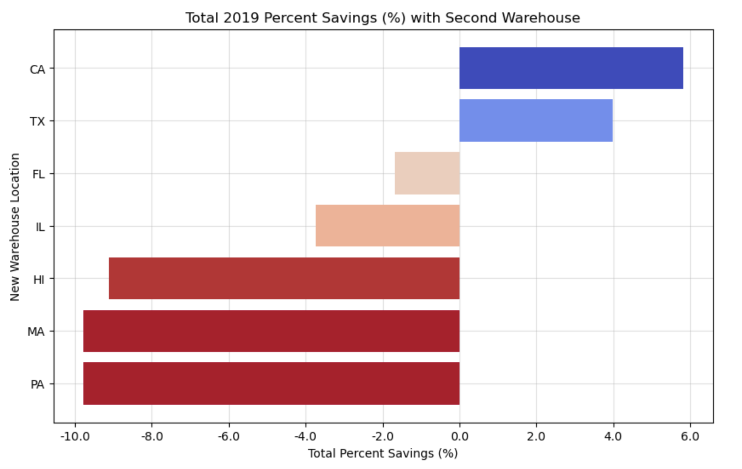
Savings Opportunities
Another warehouse in CA would allow us to reduce costs the most, with 5.8% in total savings.
Notes:
Another warehouse in CA would allow us to reduce costs the most, with 5.8% in total savings.
The next optimal location for a warehouse would have been TX, which would've reduced costs by almost 4%.

Slide 12
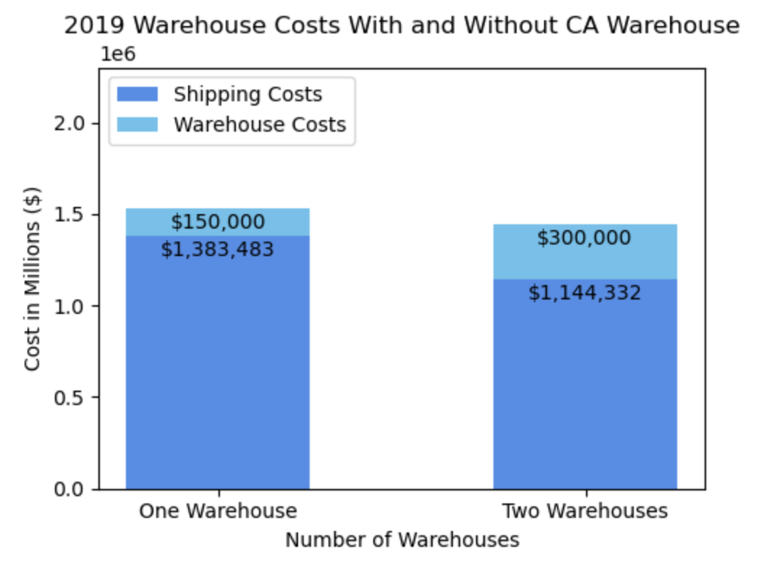
Savings Opportunities
With a second warehouse in CA in 2019, we would have saved:
~$89K on total costs.
That's ~5.8% in savings.
~$239K on shipping costs.
That’s ~17.3% in savings.
Only 79% of our total annual spend would have been due to shipping costs.

Slide 13
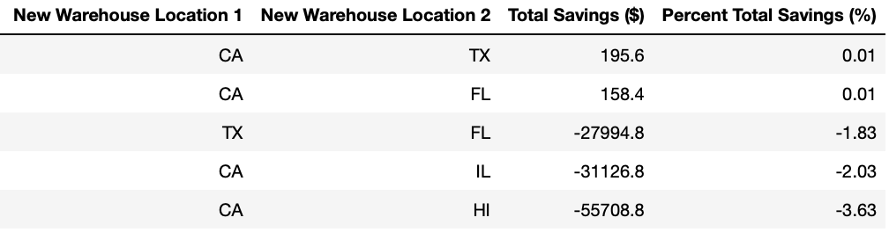
Future Savings Opportunities
After running a simulation for
all possible pairs of new warehouses, we found a second warehouse in CA and a third warehouse in TX would not maximize savings.
No other pairs of warehouses were found to maximize savings.

Slide 14
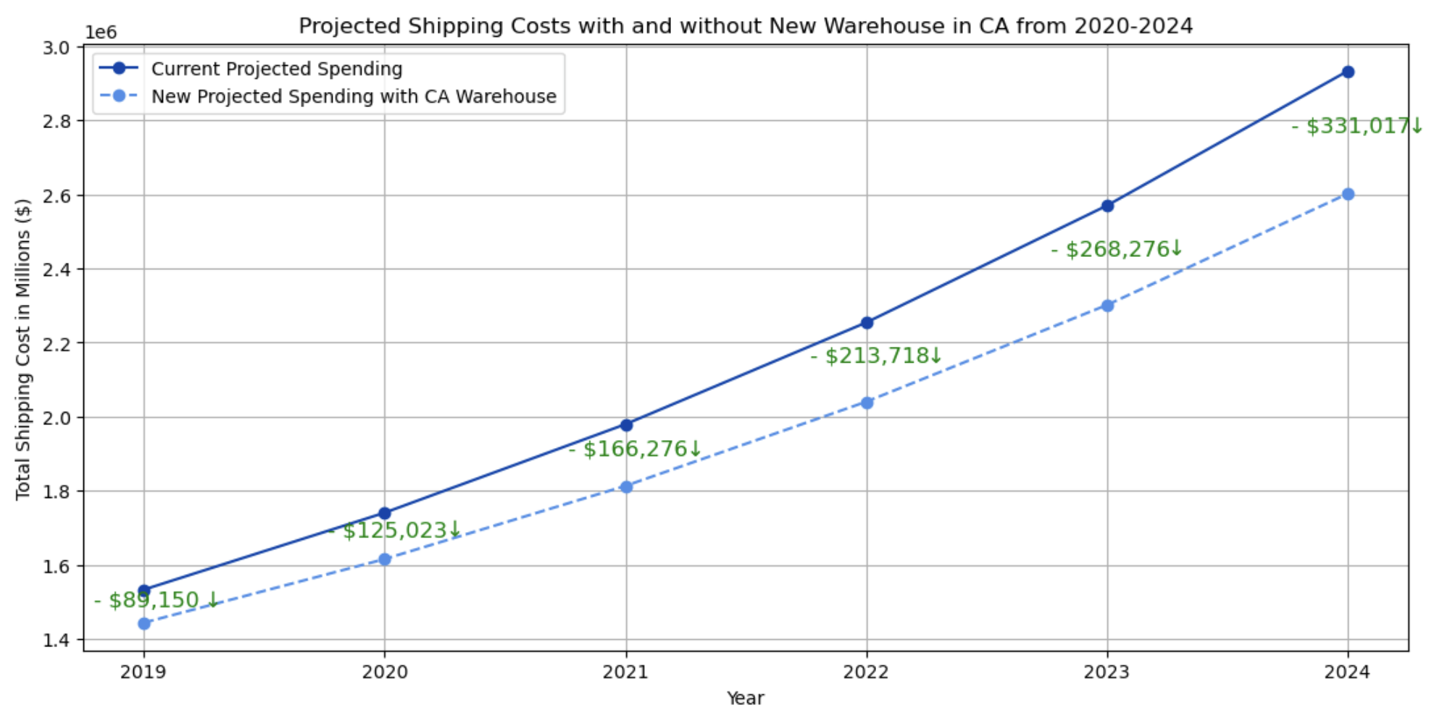
Future Savings Opportunities

Slide 15
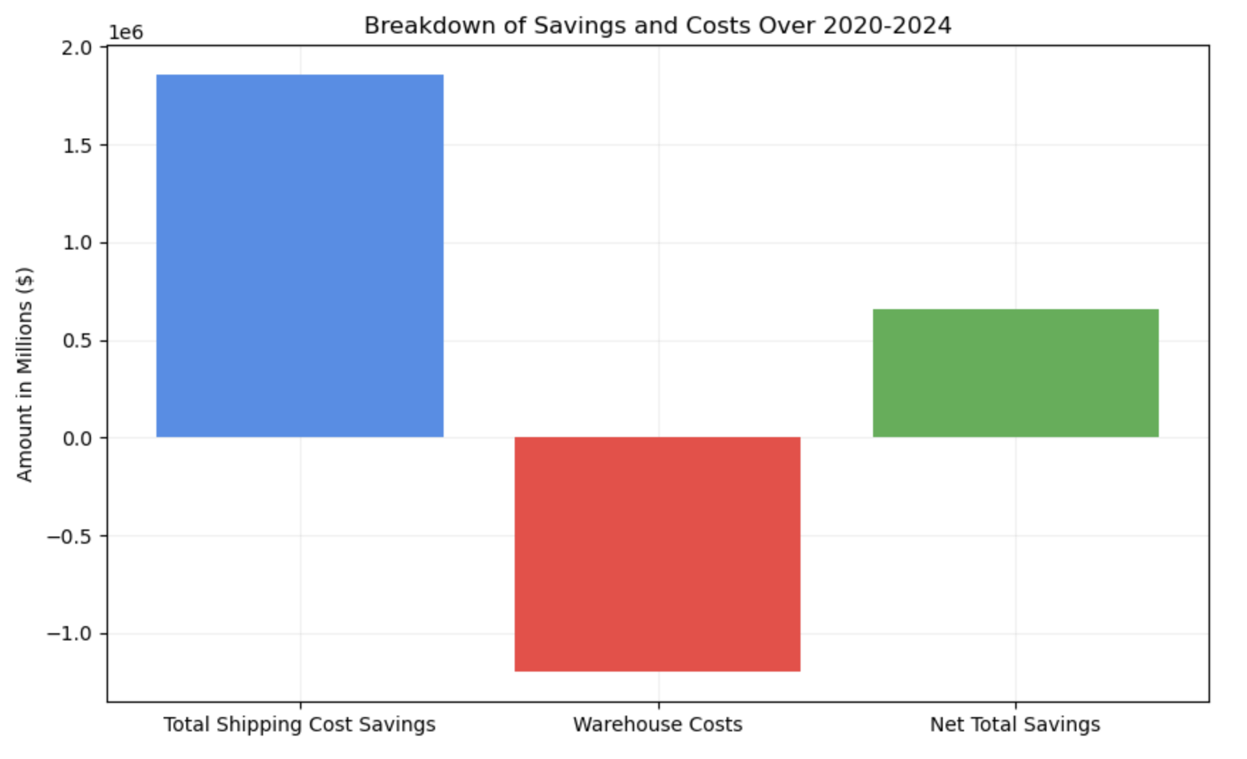
Future Savings Opportunities
+ $1.854,309.64
+ $654,309.64
- $1,500,000
Our net savings over the next 5 years would be $654,309.64

Slide 16
Recommendations
A single additional warehouse would save costs and hold long-term benefits.
The optimal location for a second warehouse is in California.
By opening a second warehouse in CA, over the next 5 years:
We’d save a grand total of $1.1M.
That's 9.62% in total savings.
We’d save $1.85M on shipping costs alone.
Warehouse costs would be: $300K a year → $1.5M over 5 years.
This makes our net savings: $654,309.64.
Notes:
Net savings: specifically reflects the balance between savings on shipping costs and the additional fixed costs incurred by operating the warehouses.

